Slide 1
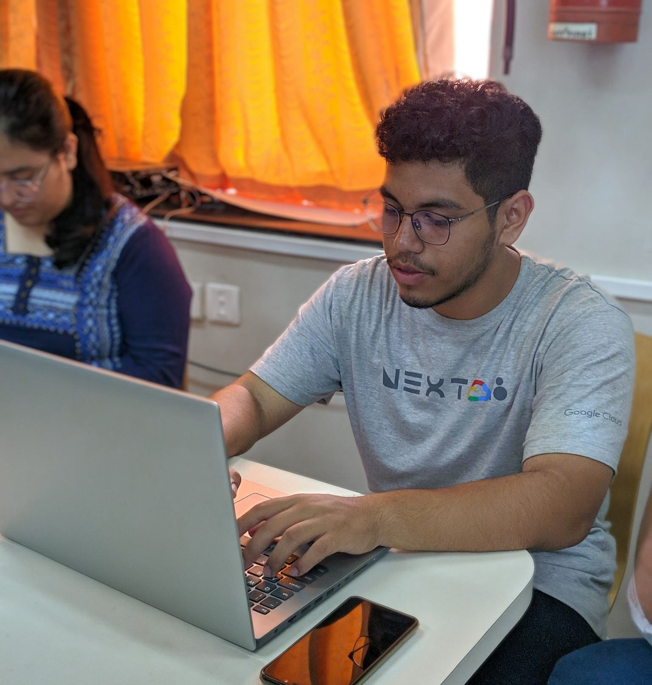
Introduction to GDSC
Hridyesh Singh Bisht

Slide 2
GDSC?
Google Developer Student Clubs (GDSC) are community groups for college and university students interested in Google developer technologies. Students from all undergraduate or graduate programs with an interest in growing as a developer are welcome.

Slide 3
Why Join GDSC?
By joining a GDSC, students grow their knowledge in a peer-to-peer learning environment and build solutions for local businesses and their community.

Slide 4
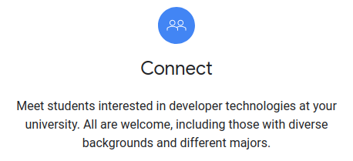
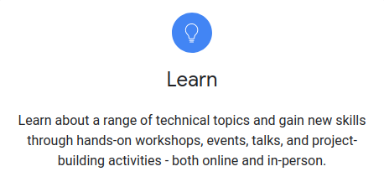
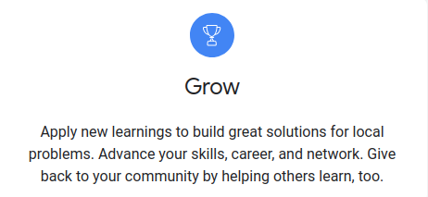
Major Benefits?
Credits: https://developers.google.com/community/dsc

Slide 5
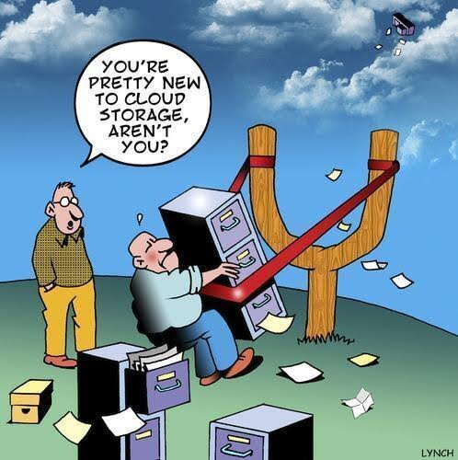
Cloud?
Probably not the cloud you are thinking, but here cloud means a set of services that allow you to create a bunch of solutions.

Slide 6
Why Choose Cloud?
When you build on cloud, you get faster more scalable and highly reliable infrastructure or software. So you focus on your logic/ source code rather than focusing on resources.
Fun fact: you could deploy a global solution in a matter of minutes.

Slide 7
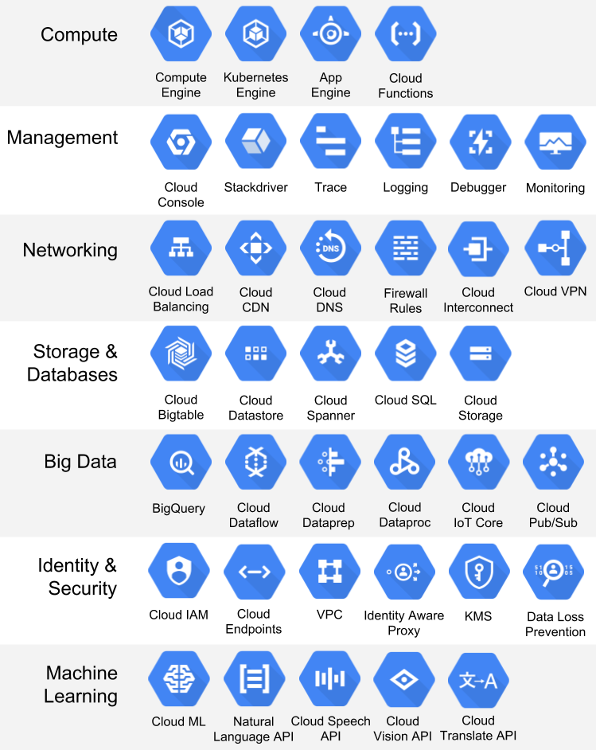
Categorization of
Platform
Google Cloud Platform (GCP) can often be categorized into 4 major categories,
1.Compute
2.Storage
3.Networking
4.Big Data
Credits: https://static.packt-cdn.com/products/9781838647438/graphics/2622d854-c8a6-4189-99a7-c55e31bc5fae.png

Slide 8
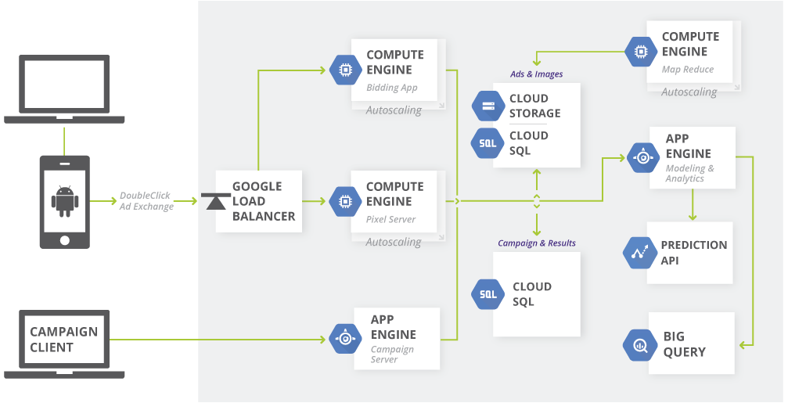
Credits: https://cloud.google.com/images/02_RealTimeBidding_ArchDiagram.png?hl=SR

Slide 9
Useful Links for cloud
https://cloud.google.com/products/
https://cloud.google.com/free/
https://cloud.google.com/getting-started/
https://gdsc.community.dev/

Slide 10
“The technology you use impresses no one. The experience you create with it is everything.”
-Sean Gerety

